Slide 1

Academic researchers for Dengue Therapeutics
Presented By:
Group 9

Slide 2
Table of Contents
Data
Preliminary analysis 2.1 Institutions with the most publications 2.2 Active researchers 2.3 Working relationship between researchers
Additional visualizations
Future objectives

Slide 3
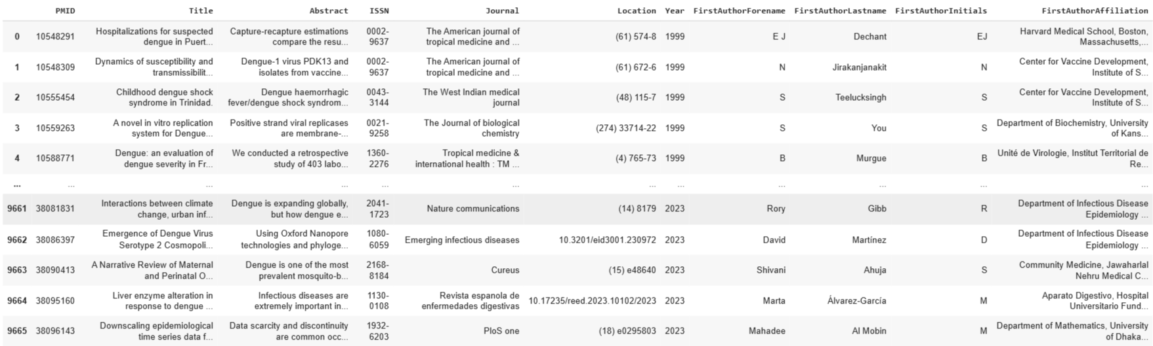
Data
Articles
Contains information regarding the number of dengue articles published in PUBMED.
The data starts from the year 1960 and continues until 2024.

Slide 4
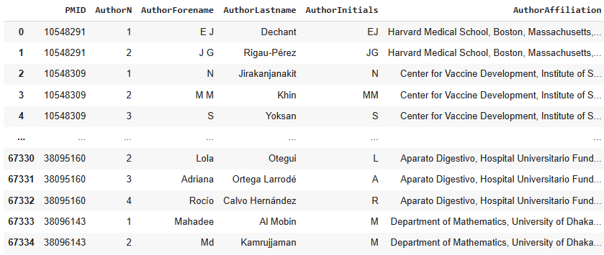
2. Authors
Contains information regarding the number of authors who have worked on an article.

Slide 5
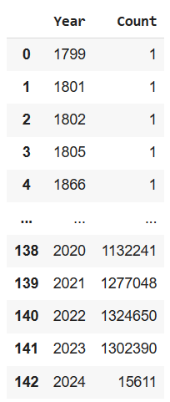
3. Paper count
Provides information on the number of papers posted in PUBMED per year.
The data starts from the year 1799 and continues until 2024.

Slide 6
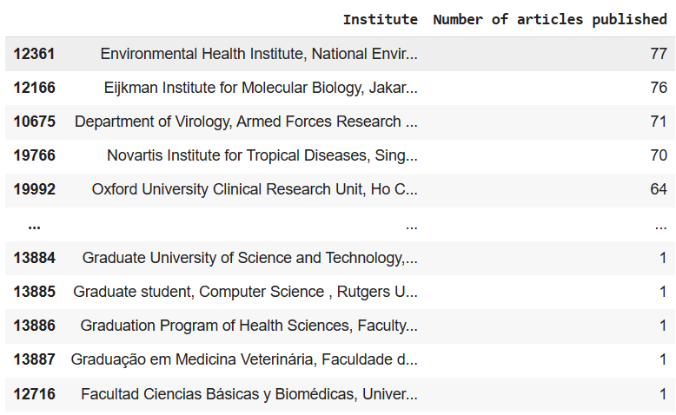
Institutions with the most publications
Preliminary analysis
Institutions with the most number of dengue article publications.
The number of publications by an institute ranges from 77 publications to 1 publication.

Slide 7
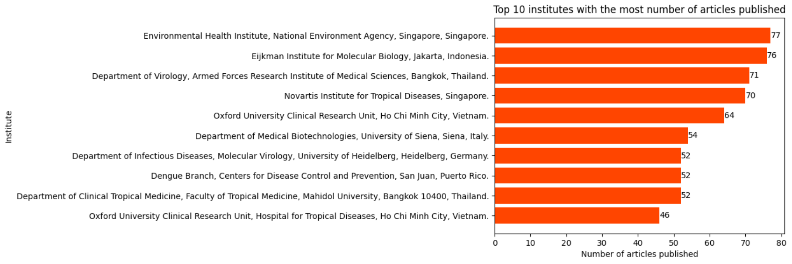
Top 10 institutions with the most publications

Slide 8
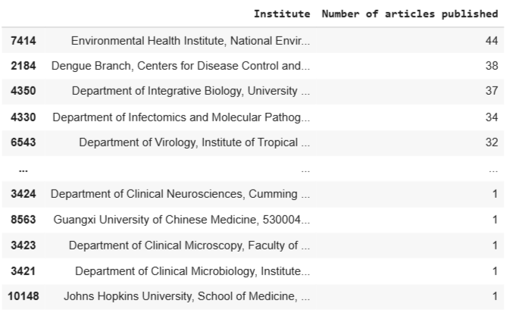
Institutions with the most publications since 2018
Institutions with the most number of dengue article publications since 2018
The number of articles published ranges from 44 to 1.

Slide 9
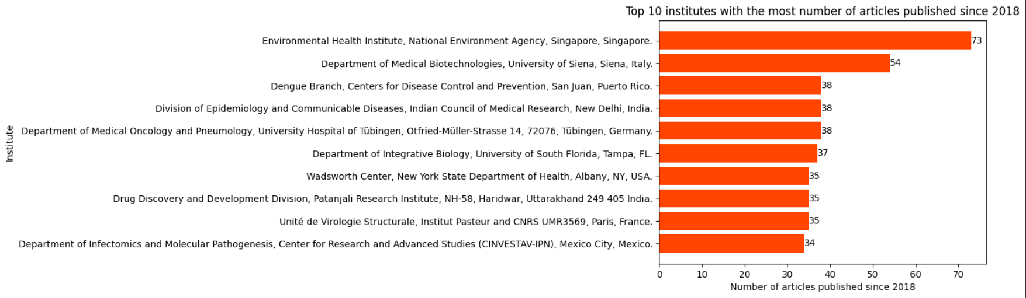
Institutions with the most publications since 2018

Slide 10
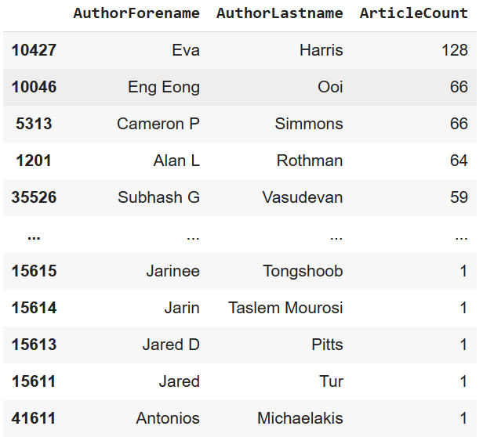
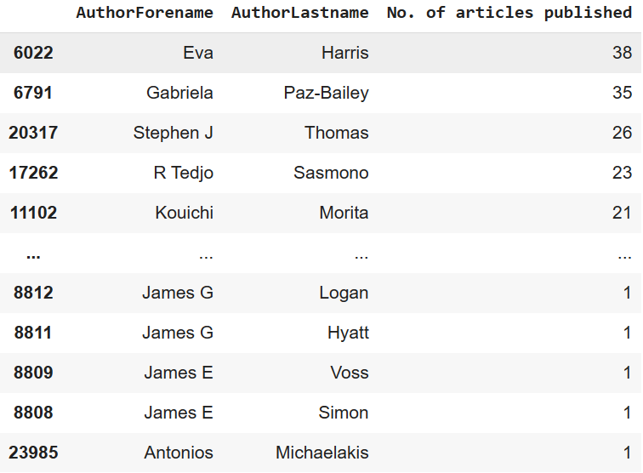
Active researchers
Overall Article Contributions
Articles Published in Last 5 Years

Slide 11
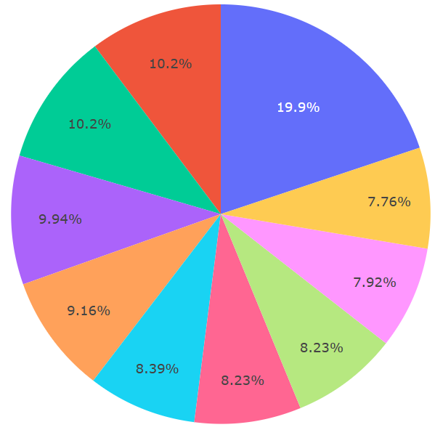

Top Researchers by Total Number
of Publications

Slide 12
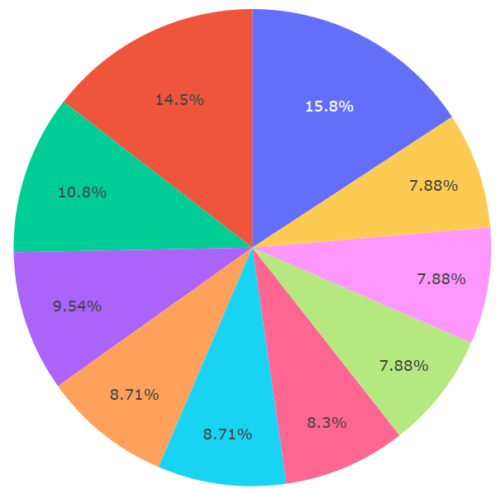
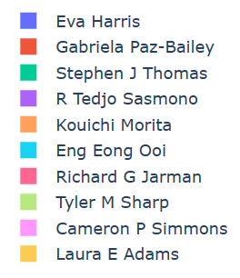
Top 10 Active Researchers in Last 5 Years

Slide 13
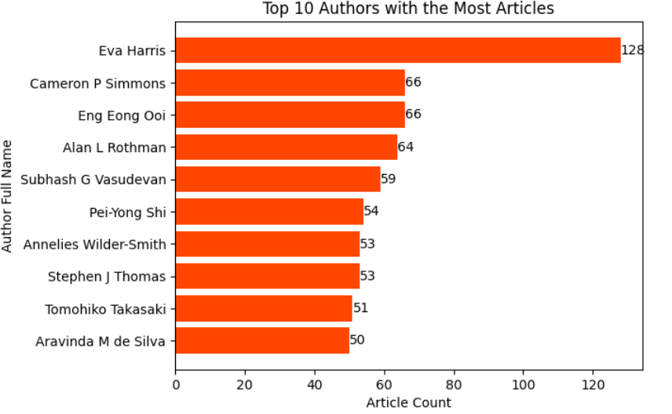
Top Researchers by Total Number of Publications
The bar plot presents the top authors based on the publications

Slide 14
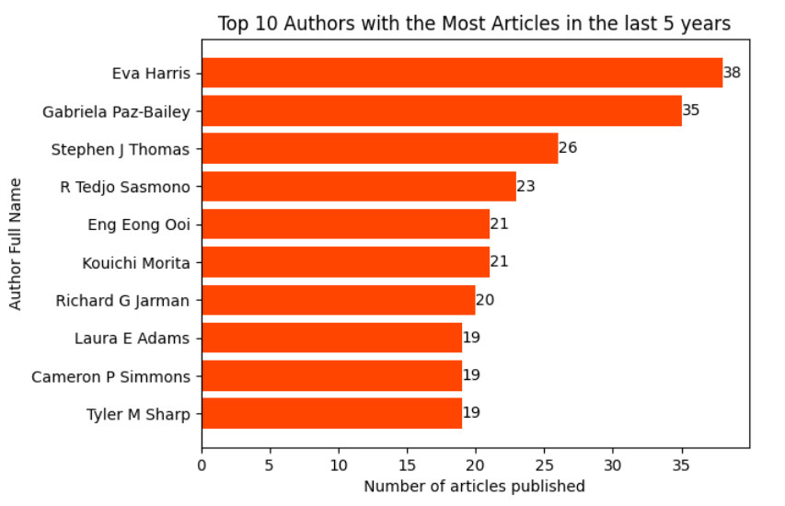
Top 10 Active Researchers in Last 5 Years
This bar plot highlights the publication activity of the foremost researchers from 2018 to 2024

Slide 16
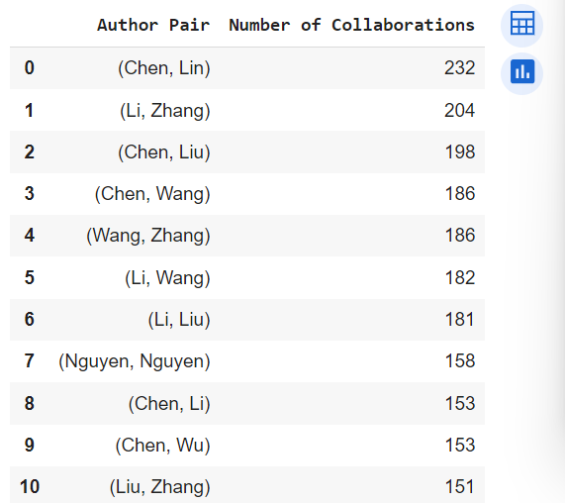
Working relationship between authors
As we have a really complex data for who works with whom.
We see here who has most no. of collaborations with others.

Slide 17
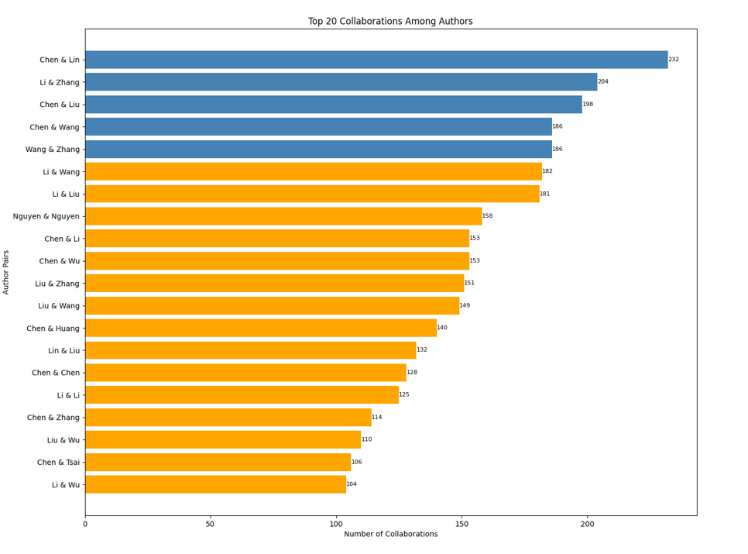

Slide 18
Top 5 people collaborated with each other
Chen & Lin
Li & Zhang
Chen & Liu
Chen & Wang
Wang & Zhang

Slide 19
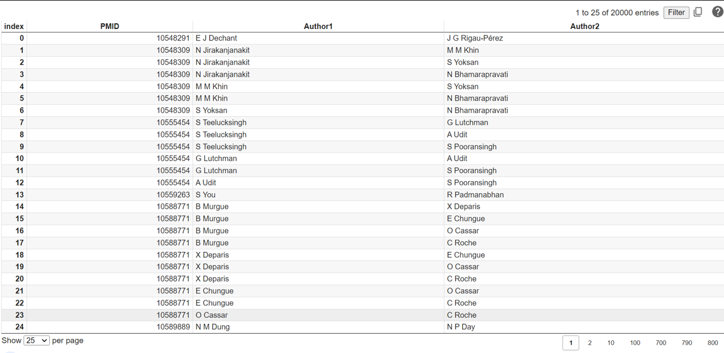
Who is working with whom

Slide 20
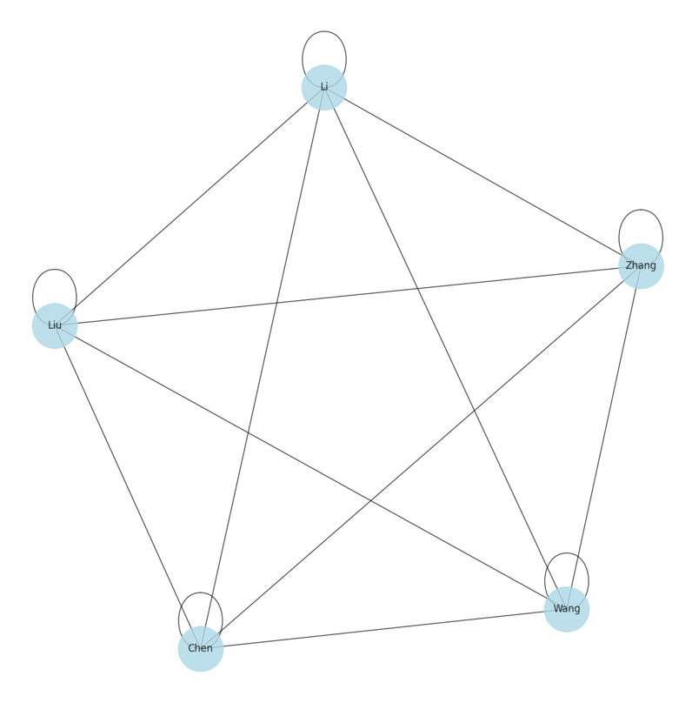
Possible Visualization
The Network graph showing the visualization of Collaboration Network of Top 5 Researchers.

Slide 21
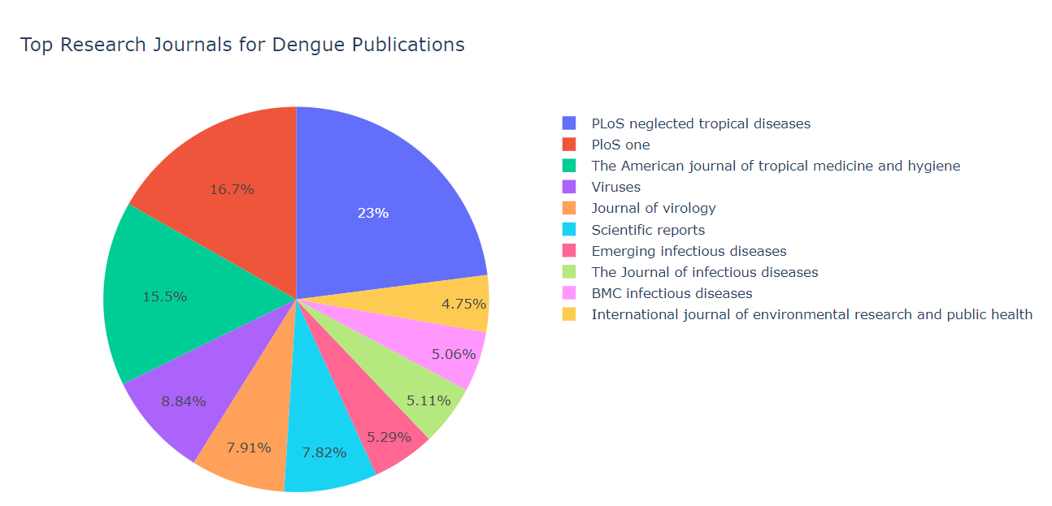
Additional visualizations
Top Research Journals for dengue publication
The pie chart representing the top research journals for Dengue publications.
Each slice of the pie corresponds to a journal, and its size reflects the proportion of publications in that journal relative to the others in the top 10 list.

Slide 22
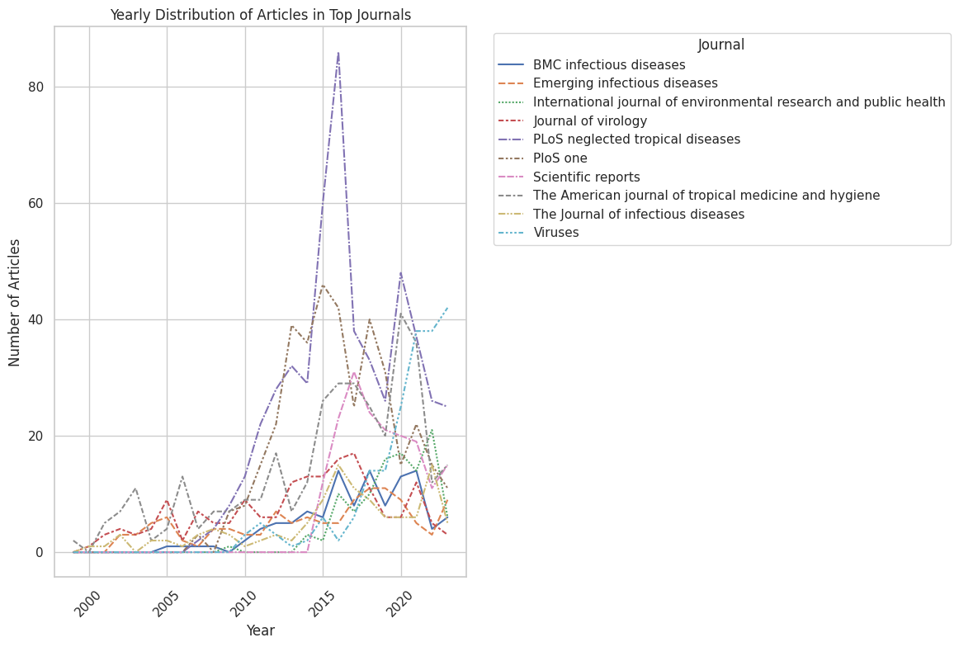
Yearly Distribution of Articles in Top Journals
The Line plot visualizes the yearly distribution in the top journals.
Each line represents a journal, and the plot shows how the number of articles in each of these journals has changed over the years.

Slide 23
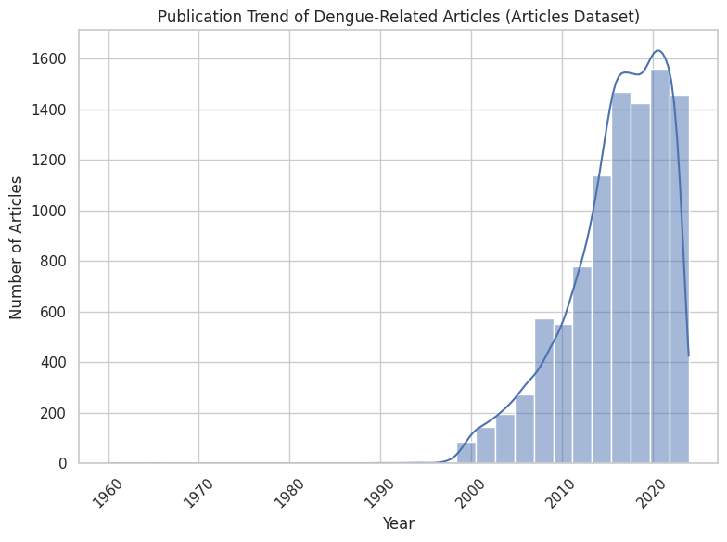
Publication Trend of Dengue-Related Articles
This histogram shows the distribution of over the years, It provides a visual representation of the publication trend, which can be compared with the trend observed in the dataset.

Slide 24
Future objectives
Handling the data for the visualizations.
Who is working for longest amount of Time from Active Researches.
Who is working with whom network diagram.
Best researches ideal as a academic partner.

Slide 25
Any Questions !

Slide 26


